Slide 1
Eliquis- Dvostruka superiornost u odnosu na varfarin u Aristotle studiji
Dr Slobodanka Crnčević

Slide 2
PROCJENA RIZIKA
TROMBOEMBOLIJA KRVARENJE
KONGESTIVNO ZATAJENJE SRCA ILI EFLV≤35% 1 | Congestive heart failure or EFLV ≤35%
HIPERTENZIJA 1 | Hypertension
DOB ≥ 75 GODINA 2 | Age ≥ 75 year
DIJABETES 1 | Diabetes
MU/TIA/SISTEMSKA EMBOLIJA 2 | Stroke/TIA/systemic embolism
ARTERIJSKA BOLEST IM/PAD/PLAK AORTE 1 | Vascular disease MI/PAD/aortic plaque
DOB 65-74 GODINE 1 | Age 65-74 years
SPOL (ŽENE) 1 | Sex (female)
HIPERTENZIJA (>160 mmHg sist) 1 | Hypertension
Oštećena BUBREŽNA i JETRENA funkcija 1ili2 | Abnormal renal or liver function
MOŽDANI UDAR 1 | Stroke
KRVARENJE 1 | Bleeding
LABILAN INR (TR<60%) 1 | Labile INR
STARIJA DOB (>65 god) 1 | Elderly
LIJEKOVI ILI ALKOHOL 1 ili 2 | Drugs or alcohol
CHA₂DS₂VASc
HAS BLED
1. Kirchhof et al. European Heart Journal. 2016; pii: ehw210; 2. Lip et al. Stroke 2010;41:2731–2738
Notes:
Pitanje DDB: Vidimo da je kod bolesnika visok rizik tromboembolijskog događaja, ali i krvarenja. Kako donijeti odluku i o čemu je posebno važno voditi računa, na što uopće možemo utjecati?
Odgovor VBL: Potencijalna korist sprječavanja tromboembolijskog događaja u odnosu na potencijalni rizik krvarenja je veća i u ovom slučaju ima prednost. Pri tome se treba voditi računa o komponentama HAS BLED skora na koje možemo utjecati. Dakle, voditi računa o dobroj regulaciji hipertenzije, o pažljivom nadzoru bubrežne i jetrene funkcije, u ovom slučaju posebno s obzirom na sistemsku narav RA, te o pažljivom nadzoru farmakoterapije.
Pitanje BBM: O kojim lijekovima kod ovog bolesnika treba voditi računa? Što s NSAR? Što s ASK?
Odgovor VBL: Kod ovog bolesnika s obzirom na dijagnozu RA, važno je pravilno kupiranje boli, ali i gastroprotekcija u slučaju potrebe propisivanja NSAR (već zbog dobi je pri propisvanju NSAR u srednjem riziku GI krvarenja) i potrebna je gastroprotekcija s IPP jednokratno u najnižnoj dozi. Zbog KV rizika prednost kod ovog bolesnika imaju COX-2 inhibitori. ASK bi trebalo izbjegavati, a u slučaju potrebe za ASK još više raste rizik kravrenja i također je obavezna gastroprotekcija .

Slide 3
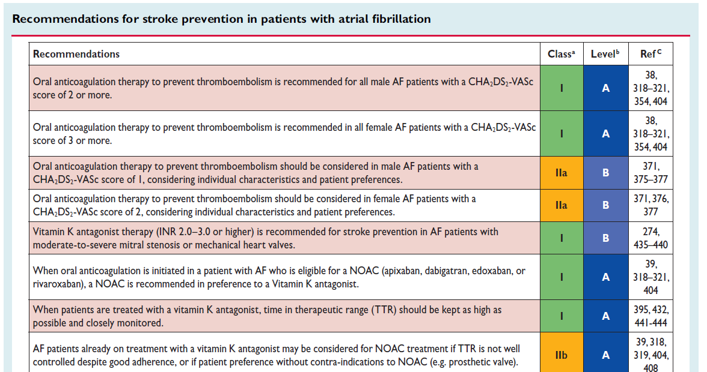
ESC 2016 smjernice za bolesnike s NVAF¹
CHA₂DS₂-VASc = 4
ªKlasa preporuke
^{b}Razina dokaza
Prilagođeno iz Kirchhof et al. 2016¹
1. Kirchhof et al. European Heart Journal. 2016; pii: ehw210.

Slide 4
Meta analiza: Učinkovitost NOAKa vs. varfarin u prevenciji moždanog udara kod bolesnika s NVAF-om¹
Stroke or SE
Study | NOAC (events) | Warfarin (events) | RR (95% CI) | RR (95% CI) | P value
ROCKET AF (rivaroxaban)† | 269/7,081 | 306/7,090 |  | 0.88 (0.75–1.03) | 0.12
ARISTOTLE (apixaban)‡ | 212/9,120 | 265/9,081 |  | 0.80 (0.67–0.95) | 0.012
Combined (random) | 911/29,312 | 1,107/29,229 |  | 0.81 (0.73–0.91) | <0.0001
0.5
1.0
2.0
Reproduced from Ruff et al. 2014.¹
Favours NOAC
Favours warfarin
Data are n, unless otherwise indicated.
Heterogeneity: I²=47%, P=0.13
Nisu provedena izravna usporedna ispitivanja, pa se lijekovi ne smiju izravno uspoređivati.
1. Ruff CT, et al. Lancet 2014;383:955–962.
*150 mg BID; †20 mg OD; ‡5 mg BID; §60 mg OD.
BID: twice daily; CI: confidence interval; NOAC: non-VKA oral anticoagulant; NVAF: non-valvular atrial fibrillation; OD: once daily; RR: relative risk; SE: systemic embolism.

Slide 5
Meta analiza: Sigurnost NOAKa vs. varfarin u prevenciji moždanog udara kod bolesnika s NVAF-om¹
Major bleeding
Study | NOAC (events) | Warfarin (events) | RR (95% CI) | RR (95% CI) | P value
ROCKET AF (rivaroxaban)† | 395/7,111 | 386/7,125 |  | 1.03 (0.90–1.18) | 0.72
ARISTOTLE (apixaban)‡ | 327/9,088 | 462/9,052 |  | 0.71 (0.61–0.81) | <0.0001
Combined (random) | 1,514/29,287 | 1,802/29,211 |  | 0.86 (0.73–1.00) | 0.06
Reproduced from Ruff et al. 2014.¹
0.5
1.0
2.0
Favours NOAC
Favours warfarin
Nisu provedena izravna usporedna ispitivanja, pa se lijekovi ne smiju izravno uspoređivati.
Data are n, unless otherwise indicated.
Heterogeneity: I²=83%, P=0.001
1. Ruff CT, et al. Lancet 2014;383:955–962.
*150 mg BID; †20 mg OD; ‡5 mg BID; §60 mg OD.
BID: twice daily; CI: confidence interval; NOAC: non-VKA oral anticoagulant; NVAF: non-valvular atrial fibrillation; OD: once daily; RR: relative risk.

Slide 6
Meta analiza: NOAKi vs. varfarin – sekundarna učinovitost i sigurnosni profil ¹
Endpoint | RR (95% CI) |  | P value | Pooled NOAC events | Pooled warfarin events
Efficacy
Ischaemic stroke |  | 0.92 (0.83–1.02) | 0.10 | 655/29,292 | 724/29,221
Haemorrhagic stroke |  | 0.49 (0.38–0.64) | <0.0001 | 130/29,292 | 263/29,221
Myocardial infarction |  | 0.97 (0.78–1.20) | 0.77 | 413/29,292 | 432/29,221
All cause mortality |  | 0.90 (0.85–0.95) | 0.0003 | 2,022/29,292 | 2,245/29,221
Safety
Intracranial haemorrhage |  | 0.48 (0.39–0.59) | <0.0001 | 204/29,287 | 425/29,221
GI bleeding |  | 1.25 (1.01–1.55) | 0.043 | 751/29,287 | 591/29,221
0.2
0.5
1.0
2.0
Reproduced from Ruff et al. 2014.¹
Favours NOAC
Favours warfarin
Data are n, unless otherwise indicated.
1. Ruff CT, et al. Lancet 2014;383:955–962.
CI: confidence interval; GI: gastrointestinal; NOAC: non-VKA oral anticoagulant; RR: relative risk.

Slide 7
ARISTOTLE: Apiksaban je dokazao superiornost naspram varfarina u prevenciji MU ili SE¹
100
4
Warfarin
80
3
RRR 21%
ARR 0.33%
HR=0.79 (95% CI: 0.66–0.95)
P<0.001 for non-inferiority
P=0.01 for superiority
60
2
Apixaban
Patients with event (%)
40
1
0
20
0
6
12
18
24
30
0
0
6
12
18
24
30
Months
Number at risk
Apixaban | 9,120 | 8,726 | 8,440 | 6,051 | 3,464 | 1,754
Warfarin | 9,081 | 8,620 | 8,301 | 5,972 | 3,405 | 1,768
Reproduced from Granger et al. 2011.¹
ARR: absolute relative risk; CI: confidence interval; HR: hazard ratio; RRR: relative risk reduction; SE: systemic embolism.
1. Granger CB, et al. N Engl J Med 2011;365:981–992.

Slide 8
ARISTOTLE: Apiksaban značajno smanjuje rizik od velikog krvarenja vs. varfarin¹
100
8
Warfarin
80
6
RRR 31%
ARR 0.96%
HR=0.69 (95% CI: 0.60–0.80)
P<0.001
60
4
Patients with event (%)
Apixaban
40
2
0
20
0
6
12
18
24
30
0
0
6
12
18
24
30
Months
Number at risk
Apixaban | 9,088 | 8,103 | 7,564 | 5,365 | 3,048 | 1,515
Warfarin | 9,052 | 7,910 | 7,335 | 5,196 | 2,956 | 1,491
Reproduced from Granger et al. 2011.¹
Major bleeding defined by ISTH criteria.
ARR: absolute relative risk; CI: confidence interval; HR: hazard ratio; ISTH: International Society for Thrombosis and Haemostasis; RRR: relative risk reduction.
1. Granger CB, et al. N Engl J Med 2011;365:981–992.

Slide 9
ARISTOTLE: Apiksaban statistički značajno smanjuje smrtnost zbog bilo kojeg uzroka¹ vs. varfarin
Key secondary efficacy endpoint: all-cause mortality
HR=0.89
(95% CI: 0.80–0.99; P=0.047)
RRR 11%, ARR 0.42%
3.94%
3.52%
Event rate (%/year)
Created from Granger et al. 2011.¹
ARR: absolute relative risk; CI: confidence interval; HR: hazard ratio; RRR: relative risk reduction.
1. Granger CB, et al. N Engl J Med 2011;365:981–992.

Slide 10
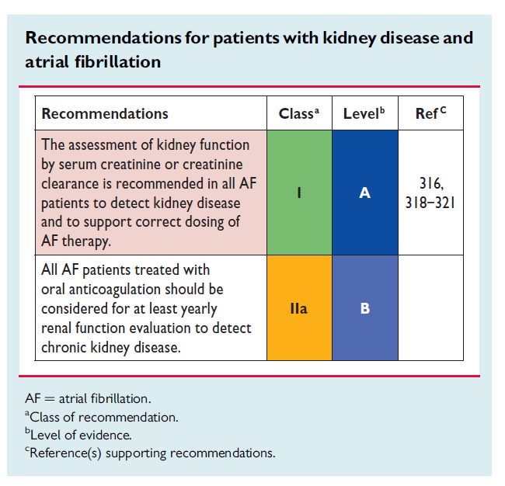
ESC 2016 smjernice za NVAF bolesnike s CKD¹
ESC 2016 Smjernice:
“Bubrežna funkcija trebala bi se redovno pratiti kod AF bolesnika na OAK terapiji kako bismo mogli prilagoditi dozu bolesnika na NOAK-ima (Slika) i procjeniti rizik."
1. Kirchhof et al. European Heart Journal. 2016; pii: ehw210.

Slide 11
Što znamo o Eliquisu kod starijih bolesnika?¹
Subgroup | No. of patients | Apixaban | Warfarin |  | HR (95% CI) | P value for interaction
 |  | No. of events (%/year)
Stroke/SE* |  |  |  |  |  | 0.11†
<65 year | 5,471 | 51 (1.00) | 44 (0.86) |  | 1.16 (0.77–1.73)
65–<75 year | 7,052 | 82 (1.25) | 112 (1.73) |  | 0.72 (0.54–0.96)
≥75 year | 5,678 | 79 (1.56) | 109 (2.19) |  | 0.71 (0.53–0.95)
Major bleeding‡ |  |  |  |  |  | 0.63†
<65 year | 5,455 | 56 (1.17) | 72 (1.51) |  | 0.78 (0.55–1.11)
65–<75 year | 7,030 | 120 (1.99) | 166 (2.82) |  | 0.71 (0.56–0.89)
≥75 year | 5,655 | 151 (3.33) | 224 (5.19) |  | 0.64 (0.52–0.79)
0.25
0.50
1.00
2.00
Apixaban better
Warfarin better
Adapted from Halvorsen et al. 2014¹
*Primary efficacy outcome; †Interaction P values based on continuous age; ‡Primary safety outcome.
1. Halvorsen S, et al. Eur Heart J 2014;35:1864–1872.

Slide 12
Upotreba reducirane doze u kliničkoj praksi
Pravi razlog za povećano propisivanje niže doze u kliničkoj praksi je nejasan
Populacija uključena u RWD analize razlikuje se od one uključene u randomiziranim kliničkim ispitivanjima, što može biti uzrok zapaženim razlikama u upotrebi niže doze
Propisivači bi mogli razmotritri dodatne smjernice (EHRA Practical Guide)¹ za prilagodbu doziranja
Usprkos povećanoj upotrebi niže doze u RWD u odnosu na RCT, rezultati u kliničkoj praksi komplementarni su onima iz ARISTOTLE-a
EHRA: European Heart Rhythm Association; RWD: real-world data.
1. Heidbuchel H, et al. Europace 2015;17:1467−1507.

Slide 13

Doziranje Apiksabana za prevenciju MU u NVAF:
redukcija doze prema ABC-kriteriju¹
PREPORUČENA DOZA ELIQUISA JE 5 mg DVAPUT NA DAN
“ABC” kriteriji za snjiženje doze:
Age ≥ 80 years
Body weight ≤ 60 kg
Najmanje 2 značajke
Creatinine in serum
≥ 1.5 mg/dL (133 µmol/L)
Apiksaban 2.5 mg
twice daily
Teško bubrežno oštećenje
CrCl: 15–29 mL/min
Apiksaban 2.5 mg
twice daily
1. Apixaban SmPC. Available at http://www.ema.europa.eu.

Slide 14
Sekundarna prevencija

Slide 15

OAK-i su efikasniji od aspirina za sekundarnu prevenciju moždanog udara u AF
EAFT: European, multicentre RCT¹
1,007 patients with non-rheumatic AF and recent TIA or minor ischaemic stroke (mean follow-up 2.3 years)
70
66%
Stroke risk reduction vs placebo (%)
60
p<0.0
50
P<0.001
40
01
30
20
14%
10
n.s.
0
OAC
(INR 2.5–4.0)
ASA
(300 mg/day)
Primary endpoint was death from cardiovascular disease, non-fatal stroke, non-fatal myocardial infarction, or systemic embolism; ASA: acetylsalicylic acid; EAFT; European atrial fibrillation trial; INR: international normalised ratio; OAC: oral anticoagulant; RCT: randomised controlled trial; TIA: transient ischaemic attack.
1. EAFT Study Group. Lancet 1993;342:1255–1262.

Slide 16




AVERROES: dizajn studije ^{1,2}
Mean follow-up: 1.1 years
Event driven
Patient Population
◆ Patients ≥50 years with NVAF and ≥1 risk
factors for stroke
◆ Not receiving VKA therapy (demonstrated or expected to be unsuitable for VKA)
N=5599
Apixaban 5.0 mg BID
(2.5 mg in select patients* [6.4%])
Randomised, double-blind, double-dummy
ASA 81–324 mg QD**
*Patients with ≥2 of the following: age ≥80 years, weight ≤60 kg, serum creatinine ≥1.5 mg/dL (133 μmol/L)
**The selection of an ASA dose of 81, 162, 243, or 324 mg was at the discretion of the investigator with 91% of subjects receiving either an 81 mg (64%) or 162 mg (27%) dose at randomisation.
Primarni cilj studije je bio da pokaže je li apixaban superioran ASA za prevenciju ukupno moždanog udara I sistemske embolije
◆ Primary efficacy outcome: Stroke or systemic embolism
◆ Primary safety outcome: Major bleeding
BID: twice daily; NVAF: non-valvular atrial fibrillation; QD: once daily.
1. Apixaban SmPC. Available at: http://www.ema.europa.eu.
2. Connolly SJ, et al. N Engl J Med 2011;364:806–817.

Slide 17
AVERROES:
Moždani udar /SE kod pacijenata sa ili bez prijašnjeg moždanog udara /TIA
No Previous stroke/TIA
Previous stroke/TIA
0.12
HR 0.51 (95% CI, 0.35–0.74)
0.12
HR 0.29 (95% CI, 0.15–0.60)
0.10
0.10
Cumulative hazard
Aspirin Apixaban
Cumulative hazard
Aspirin
0.08
0.08
Apixaban
1-year ARR 6.4%
95% CI 2.8–10.0
0.06
0.06
0.04
0.04
0.02
0.02
0
0
0
3 6 9 12 15
Time since randomisation (months)
18
0
3 6 9 12 15
Time since randomisation (months)
18
Number at risk |  |  |  |  |  |  |  | Number at risk
Aspirin | 2,415 | 2,354 | 2,190 | 1,830 | 1,356 | 925 | 554 | Aspirin | 374 | 360 | 331 | 281 | 186 | 126 | 73
Apixaban | 2,417 | 2,379 | 2,220 | 1,840 | 1,335 | 938 | 548 | Apixaban | 390 | 378 | 345 | 284 | 186 | 117 | 67
ARR: absolute risk reduction; CI: confidence interval; HR: hazard ratio; SE: systemic embolism.
Extracted from Diener et al. 2012¹
1. Diener HC, et al. Lancet Neurol 2012;11:225–231.

Slide 18
AVERROES:
Veliko krvarenje kod pacijenata sa ili bez prijašnjeg moždanog udara /TIA
No Previous stroke/TIA
Previous stroke/TIA
0.06
HR 1.08 (95% CI, 0.64–1.80)
0.06
HR 1.28 (95% CI: 0.58–2.82)
0.05
0.05
Cumulative hazard
Aspirin Apixaban
Cumulative hazard
Aspirin
0.04
0.04
Apixaban
0.03
0.03
0.02
0.02
0.01
0.01
0
0
0
3 6 9 12 15
Time since randomisation (months)
18
0
3 6 9 12 15
Time since randomisation (months)
18
Number at risk |  |  |  |  |  |  |  | Number at risk
Aspirin | 2,415 | 2,367 | 2,207 | 1,851 | 1,379 | 940 | 567 | Aspirin | 374 | 369 | 341 | 288 | 191 | 130 | 74
Apixaban | 2,417 | 2,381 | 2,221 | 1,838 | 1,336 | 935 | 550 | Apixaban | 390 | 377 | 344 | 281 | 184 | 116 | 69
Extracted from Diener et al. 2012¹
1. Diener HC, et al. Lancet Neurol 2012;11:225–231.

Slide 19
ESC 2016 smijernice :sekundarna prevencija moždanog udara- NOAK-i imaju prednost u odnosu na VKA ili aspirin kod AF pacijenata s prethodnim MU
Recommendations | Class | Level
In AF patients who suffer a stroke, aspirin should be considered for prevention of secondary stroke until the initiation or resumption of oral anticoagulation. | IIa | B
Systemic thrombolysis with rtPA is not recommended if the INR is above 1.7 (or, for patients on dabigatran, if aPTT is outside normal range). | III (harm) | C
After TIA or stroke, combination therapy of OAC and an antiplatelet is not recommended. | III (harm) | B
After intracranial haemorrhage, oral anticoagulation in patients with AF may be reinitiated after 4–8 weeks provided the cause of bleeding or the relevant risk factor has been treated or controlled. | IIb | B
NOACs are recommended in preference to VKAs or aspirin
in AF patients with a previous stroke. ^{I B}
AF: atrial fibrillation; aPTT: activated partial thromboplastin time; ESC: European Society of Cardiology; rtPA: recombinant tissue plasminogen activator. Extracted from Kirchof et al. 2016¹
1. Kirchhof P, et al. Eur Heart J 2016;37:2893–2962.

Slide 20
Zaključak
◆ Najvažniji faktor rizika za moždani udar kod bolesnika s AF je prijašnji moždani udar ili TIA¹
◆ Varfarin reducira rizik ponovnog moždanog udara kod bolesnika s AF u usporedbi s placebom za 68%²
◆ Kod VKA terapije, preporučeni INR je 2.0–3.0 za primarnu prevenciju moždanog udara –kao i INR preporučen u sekundarnoj prevenciji³
◆ Antiplatelarna terapija nije više preporučena za prevenciju moždanog udara kod bolesnika s NVAF³
– Apixaban reducira rizik od moždanog udara/SE uspoređen s aspirinom, neovisno da li je pacijent prije imao ili ne moždani udar ili TIA, sa sličnim profilom tolerancije među grupama ⁴
1. Durrant J, et al. Expert Rev Cardiovasc Ther 2013;11:77–90; 2. Atrial fibrillation investigators. Arch Intern Med 1994;154:1449–1457;
3. Kirchhof P, et al. Eur Heart J 2016;37:2893–2962; 4. Diener HC, et al. Lancet Neurol 2012;11:225–231.

Slide 21


Bolesnik primljen u hitnoj službi s akutnim ishemičnim moždanim udarom
Pacijent 1.
Informacije o pacijentu
Spol | Muškarac
Godine | 80 g.
Komorbiditeti
◆ Perzistentna NVAF  Dijabetes
Trenutna terapija
◆ Warfarin  INR=1.3
Dodatne informacije
◆ Lijevostrana veća slabost  Primljen u Hitnu službu 1.5 h nakon početka simptoma  NIHSS score=9  CHA₂DS₂-VASc=5 (dijabetes, prijašnji moždani u. , ≥75 g)  HAS-BLED=2 (prijašnji moždani udar , >65 g.)
◆ Zabrinut je da mu se ne desi drugi,
ozbiljniji moždani udar
CHA₂DS₂-VASc: congestive heart failure, hypertension, age ≥75 years x 2, diabetes mellitus, stroke x 2, vascular disease, age 65–74 years; ER: emergency room; HAS-BLED: hypertension, abnormal renal and liver function, stroke, bleeding, labile INR, elderly, drugs or alcohol; NIHSS: National Institutes of Health Stroke Scale.

Slide 22
Početak antikoagulacije s VKA i rizik od moždanog udara
Uvođenje varfarina kod pacijenata s AF:
Rani efekt na ishemički moždani udar
◆ UK Clinical Practice Research Datalink
◆ 70,766 patients with AF
◆ 1993–2008
◆ Patients with stroke matched with up to 10 controls each
◆ Stroke rate after initiation of VKA therapy
Smooth cubic spline curve of the adjusted rate ratio of ischaemic stroke (red line) and 95% confidence limits (blue dashed line) as a function of
the time since initiation of warfarin
4.0
Rate ratio of ischaemic stroke
2.0
95% CI limits
1.0
Ischaemic stroke
0.5
95% CI limits
0 5 10 15 20 25 30
Time since initiation of warfarin (days)
U prvih 30 dana antikoagulacije s varfarinom : rizik od moždanog udara ↑↑
Extracted from Azouley et al. 2014¹
1. Azouley L, et al. Eur Heart J 2014;35:1881–1887.

Slide 23
Meta-analiza: prethodni moždani udar ili sistemska embolija (SE)
NOACs versus warfarin in patients with prior TIA or ischaemic stroke
Pooled NOAC events
Pooled warfarin events
Weight
RR (95% CI)
Stroke/SE
ARISTOTLE
73/1,694
98/1,742
18.6%
0.76 (0.56–1.03)
ROCKET-AF
179/3,754
187/3,714
39.9%
0.94 (0.77–1.17)
RELY (150 mg)
Total (95% CI)
428/8,657
495/8,642
100.0%
0.86 (0.75–0.98)
Heterogeneity: Chi²=1.93, df=3 (p=0.59); I²=0% Test for overall effect: Z=2.28 (p=0.02)
0.5 0.7
Favours NOAC
1.0
1.5 2.0
Favours warfarin
Redukcija rizika za rekurentni moždani udar I SE =14%
There are no head-to-head randomised clinical trials comparing the NOACs. Comparisons cannot be made between individual NOACs based on these data.
Extracted from Ntaios et al. 2017¹
1. Ntaios G, et al. Int J Stroke 2017;12:589–596.

Slide 24
Meta-analiza:smrt zbog bilo kojeg uzroka kod prethodnih moždanih udara ili embolije
NOACs versus warfarin in patients with prior TIA or ischaemic stroke
Pooled NOAC events
Pooled warfarin events
Weight
RR (95% CI)
Death from any cause
ARISTOTLE
129/1,694
150/1,742
17.9%
0.88 [0.69, 1.12]
ROCKET-AF
288/3,754
294/3,714
37.5%
0.97 [0.82, 1.14]
Total (95% CI)
756/8,657
827/8,642
100%
0.90 [0.82, 1.00]
Heterogeneity: Chi²=1.93, df=3 (p=0.59); I²=0% Test for overall effect: Z=1.89 (p=0.06)
0.5 0.7
Favours NOAC
1.0
1.5 2.0
Favours warfarin
Redukcija rizika za mortalitet=10%
There are no head-to-head randomised clinical trials comparing the NOACs. Comparisons cannot be made between individual NOACs based on these data.
Extracted from Ntaios et al. 2017¹
1. Ntaios G, et al. Int J Stroke 2017;12:589–596.

Slide 25
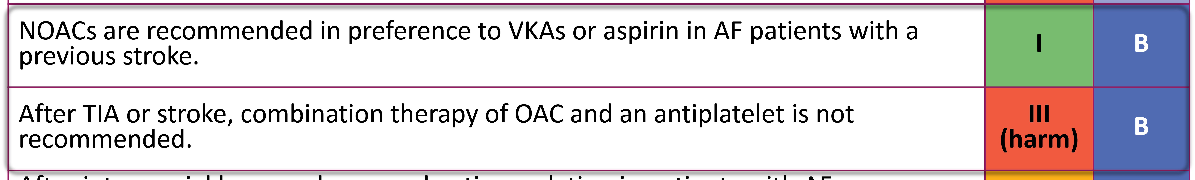
ESC 2016 guidelines: Sekundarna prevencija moždanog udara
Recommendations | Class | Level
In AF patients who suffer a stroke, aspirin should be considered for prevention of secondary stroke until the initiation or resumption of oral anticoagulation. | IIa | B
Systemic thrombolysis with rtPA is not recommended if the INR is above 1.7 (or, for patients on dabigatran, if aPTT is outside normal range). | III (harm) | C
After intracranial haemorrhage, oral anticoagulation in patients with AF may be reinitiated after 4–8 weeks provided the cause of bleeding or the relevant risk factor has been treated or controlled. | IIb | B
NOACs are recommended in preference to VKAs or aspirin in AF patients with a
previous stroke. ^{I B}
After TIA or stroke, combination therapy of OAC and an antiplatelet is not III
recommended. (harm) ^{B}
Extracted from Kirchof et al. 2016¹
Kirchhof P, et al. Eur Heart J 2016;37:2893–2962.

Slide 26
Kada biste započeli antikoagulaciju nakon TIA ili ishemičnog moždanog udara?
Pacijent 1.
Informacije o pacijentu
Spol | Muškarac
Godine | 80 g.
Komorbiditeti
◆ Persistentni NVAF  Dijabetes
Dodatne informacije
◆ CHA₂DS₂-VASc = 5 (diabetes, prior stroke, age 65–74 years)  HASBLED = 2 (prior stroke, age >65 years)  NIHSS score of 6 and a Rankin score of 2

Slide 27
“Background“:
◆ Pacijent s AF i TIA ili ishemičkim moždanim udarom ima veći rizik od rekurentnog moždanog udara u prvom tjednu nakon inicijalnog događaja ^{1,2}
◆ Ako je antikoagulacija započela prerano postoji povećan rizik od krvarenja u ishemično područje ("hemoragična transformacija”)³
◆ Potrebno je dovesti u ravnotežu benefit I rizik uvođenja antikoagulacije nakon moždanog udara
1. Grau AJ, et al. Stroke 2001;32:2559–2566; 2. Giles MF, et al. Lancet Neurol 2007;6:1063–1072;
3. Paciaroni M, et al. Thromb Haemost 2016;116:410–416.

Slide 28





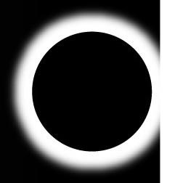
Početak ili nastavak antikoagulacije ovisi o ozbiljnosti moždanog udara*
Vrijeme re-inicijacije ovisi o veličini infarkta :^{1 “}Pravilo 1 – 3 – 6 – 12 dana "(Diener’s Law)
TIA
Mild stroke
Moderate stroke
Severe stroke
As soon as imaging has excluded a cerebral haemorrhage
3–5 days after symptom onset
5–7 days after stroke onset
2 weeks after stroke onset
Day
1
3
6
12
*Mild: NIHSS score <8, moderate: NIHSS score 8–16, severe: NIHSS score >16. Personal communication.
1. Huisman M, et al. Thromb Haemost 2012;107:838–847.

Slide 29



ESC 2016 guidelines: Početak ili nastavak antikoagulacije kod pacijenata s AF nakon moždanog udara ili TIA
Patient with AF and acute TIA or ischaemic stroke: exclusion of intracerebral bleeding by CT or MRI
TIA
Mild stroke (NIHSS <8) Moderate stroke (NIHSS 8–15) Severe stroke (NIHSS ≥16)
Consider additional clinical factors favouring early/delayed initiation of OAC
Factors favouring early initiation of OAC: Factors favouring delayed initiation of OAC:
Low NIHSS (<8)
Small/no brain infarction on imaging
High recurrence risk, e.g. cardiac thrombus on echo
No need for percutaneous endoscopic gastrostomy
No need for carotid surgery
No haemorrhagic transformation
•
•
•
High NIHSS (≥8)
Large/moderate brain infarction on imaging
Needs gastrostomy or major surgical intervention
•
•
•
•
•
Needs carotid surgery Haemorrhagic transformation Neurologically unstable Elderly patient
Uncontrolled hypertension
Clinically stable Young patient
Blood pressure is controlled
Evaluate haemorrhagic transformation (CT/MRI, day 6)
Evaluate haemorrhagic transformation (CT/MRI, day 12)
Start OAC
1 day after acute event
3 days after acute event
6 days after acute event
12 days after acute event
Extracted from Kirchof et al. 2016¹
CT: computed tomography; MRI: magnetic resonance imaging.
1. Kirchhof P, et al. Eur Heart J 2016;37:2893–2962.

Slide 30
Sažetak i zaključak
◆ Moramo razmotriti multiple faktore kada iniciramo antikoagulantnu terapiju nakon TIA ili ishemijskog moždanog udara
◆ Izmjeriti benefit od prevencije ranog trombotičkog događaja u odnosu na rizik od komplikacija kao što je krvarenje u ishemično područje
◆ Preporuke su dostupne u dorađenim ESC smjernicama
◆ NOAKi se preferiraju u odnosu na varfarin

Slide 31
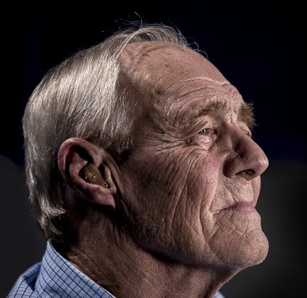
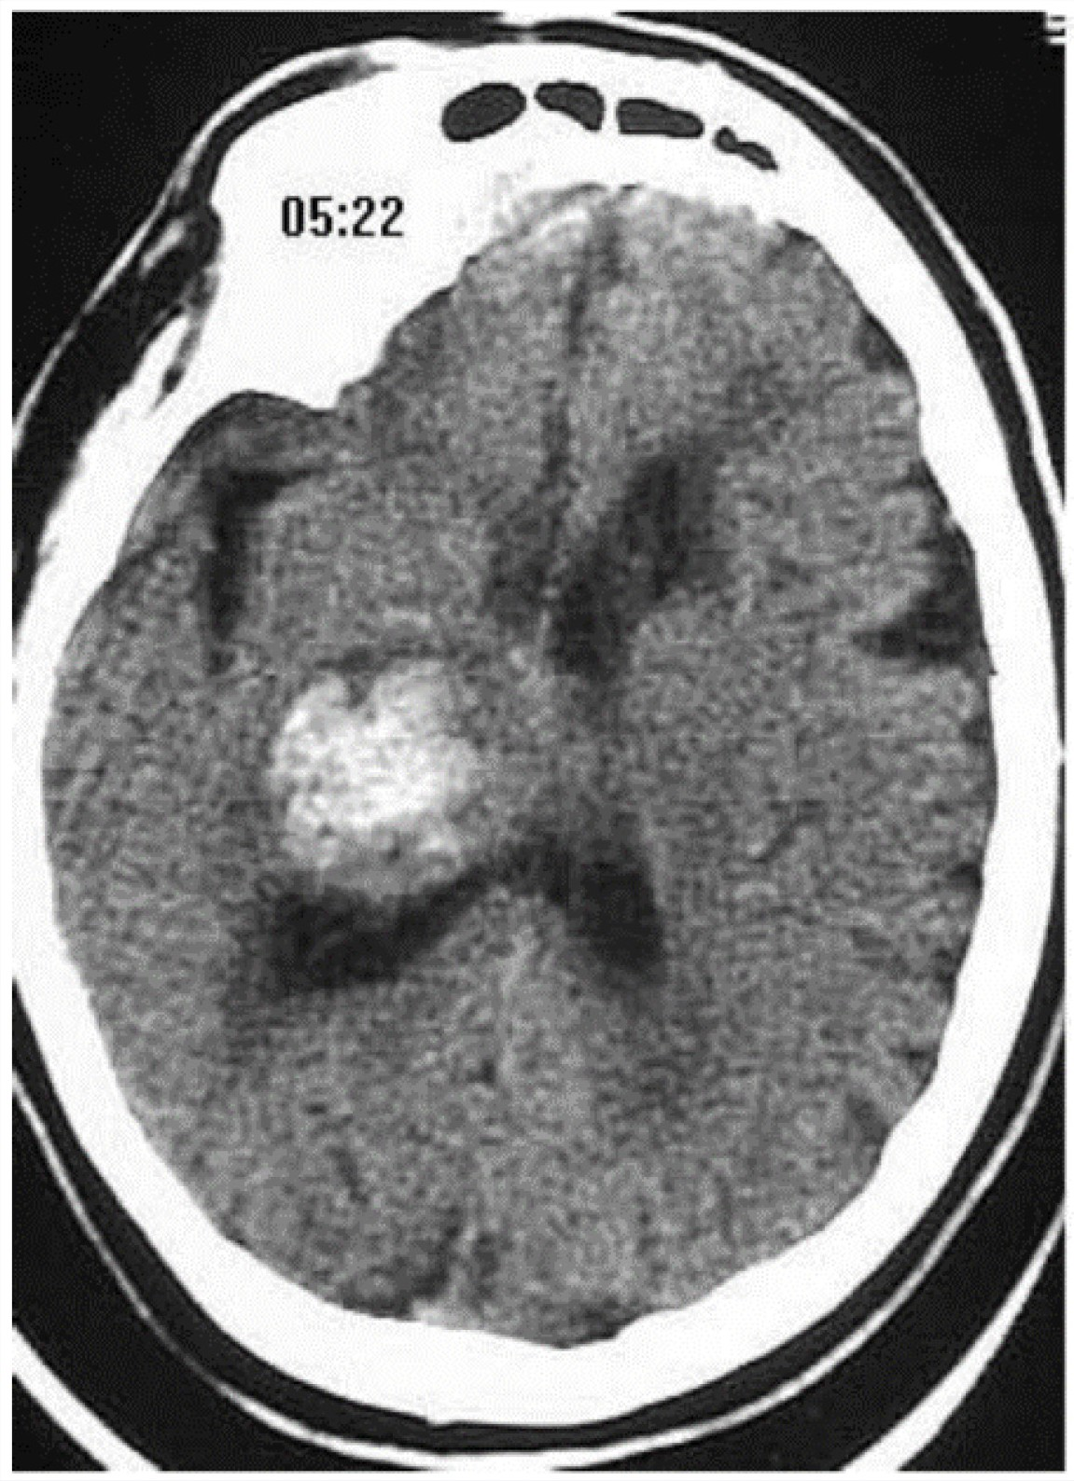
2.Pacijent je primljen s hemiparezom I glavoboljom
Pacijent 2.
Informacije o pacijentu
Spol | Muškarac
Godine | 80 g.
Komorbiditeti
◆ Persistentna NVAF  Na terapiji varfarinom  Dijabetes
Dodatne informacije
◆ Prikazan kao NIHSS score=12  INR 5.0  CT pokazuje krvarenje u bazalne ganglie

Slide 32
Meta-analiza: rizik od hemoragičnog MU kojem je prethodila TIA ili ishemični MU
In Phase III clinical trials, NOACs reduced the risk of haemorrhagic stroke by 49% compared with warfarin in patients with NVAF who had experienced a prior stroke or TIA
Pooled NOAC events
Pooled warfarin events
Peto Odds Ratio Peto, Fixed, 95% CI
Weight
Haemorrhagic stroke
ARISTOTLE (apixaban)*
12/1,694
31/1,742
26.0%
0.42 [0.23, 0.77]
ROCKET AF (rivaroxaban)§
22/3,754
30/3,714
31.6%
0.73 [0.42, 1.25]
Total (95% CI)
55/8,657
110/8,642
100%
0.51 [0.38, 0.69]
Heterogeneity: Chi²=3.44, df=3 (P=0.33); I²=13% Test for overall effect: Z=4.29 (P<0.0001)
0.1 0.2 0.5 1.0
2
5 10
Favours warfarin
Favours NOAC
There are no head-to-head randomised clinical trials comparing the NOACs. Comparisons cannot be made between individual NOACs based on these data.
*5 mg BID; †60 mg OD; ‡150 mg BID; §20 mg OD. OD, once-daily.
There are no head-to-head randomised clinical trials comparing the NOACs. Comparisons cannot be made between individual NOACs based on these data.
Extracted from Ntaios et al. 2017¹
1. Ntaios G, et al. Int J Stroke 2017;12:589–596.

Slide 33

Meta-analIZA: veliko krvarenje kod bolesnika koji su prethodno imali TIA/moždani udar
NOACs versus warfarin in patients with prior TIA or ischaemic stroke
Pooled NOAC events
Pooled warfarin events
Weight
Peto Odds Ratio Peto, Fixed, 95% CI
Major bleeding
ARISTOTLE
77/1,694
106/1,742
17.7%
0.74 (0.55–0.99)
ROCKET-AF
178/3,754
183/3,714
35.0%
0.96 (0.78–1.19)
Total (95% CI) 495/8,657
Heterogeneity: Chi²=3.36, df=3 (p=0.34); I²=11% Test for overall effect: Z=1.89 (p=0.06)
553/8,642
100.0%
0.89 (0.78–1.00)
0.5 0.7
Favours NOAC
1.0
1.5 2.0
Favours warfarin
Redukcija rizika za veliko krvarenje =11%
There are no head-to-head randomised clinical trials comparing the NOACs. Comparisons cannot be made between individual NOACs based on these data.
Extracted from Ntaios et al. 2017¹
There are no head-to-head randomised clinical trials comparing the NOACs. Comparisons cannot be made between individual NOACs based on these data.
1. Ntaios G, et al. Int J Stroke 2017;12:589–596.

Slide 34




ESC 2016 guidelines: Početak ili nastavak antikoagulacije kod pacijenata s AF nakon intrakranijalnog krvarenja(ICH)
Patient with AF suffering from an intracranial bleed on OAC
If acute event: establish intensity of anticoagulation (see bleeding flow chart)
Contra-indication for OAC
Consider further information to allow informed judgement
Factors favouring withholding of OAC: Factors supporting re-initiation of OAC:
Bleeding occurred on adequately dosed NOAC or in setting of treatment interruption or underdosing
Older age
Uncontrolled hypertension
Cortical bleed
Severe intracranial bleed
Multiple microbleeds (e.g. >10)
Cause of bleed cannot be removed or treated
Chronic alcohol abuse
Need for dual antiplatelet therapy after PCI
Bleeding occurred on VKA or in setting of overdose
Traumatic or treatable cause
Younger age
Well controlled hypertension
Basal ganglia bleed
No or mild white matter lesions
Surgical removal of subdural haematoma
Subarachnoid bleed: aneurysm clipped or coiled
High risk of ischaemic stroke
Patient or next of kin choice informed by multidisciplinary team advice
No stroke protection (no evidence)
LAA
occlusion (IIbC)
Initiate or resume OAC, choosing an agent with low intracranial bleeding risk, after 4–8 weeks (IIbB)
This approach is based on consensus within the task force, not on evidence. ICH: intracranial haemorrhage.
Extracted from Kirchhof et al. 2016¹
1. Kirchhof P, et al. Eur Heart J 2016;37:2893–2962.

Slide 35
Da li je razumna ponovna antikoagulacija nakon ICH?
ISHEMIČKI DOGAĐAJI
KRVARENJE
25
25
20
χ² P<0.001
χ² P=0.48
20
Incidence (%)
Incidence (%)
15
No OAC resumption
15
10
10
OAC resumption
5
5
OAC resumption
No OAC resumption
0
0
0 4 8 12 16 20 24 28 32 36 40 44 48 52
Time (weeks)
0 4 8 12 16 20 24 28 32 36 40 44 48 52
Time (weeks)
Extracted from Kuramatsu et al. 2015¹
Benefit OAKa za prevenciju ishemičnog moždanog udara je veći nego rizik od krvarenja
719 ICH patients (547 with no OAC resumption, and 172 with OAC resumption).¹
1. Kuramatsu JB, et al. JAMA 2015;313:824–836.

Slide 36
Sažetak i zaključak
◆ Moramo razmotriti multiple faktore kada iniciramo antikoagulantnu terapiju nakon intrakranijalnog krvarenja
◆ U slučaju kada je izvor krvarenja uklonjen ili faktori rizika liječeni I pod kontrolom , oralna antikoagulacija se može razmotriti I nastaviti nakon 4–8 sedmica
◆ NOAKi se preferirarju u odnosu na varfarin zbog njihovog manjeg rizika od ICH

Slide 37
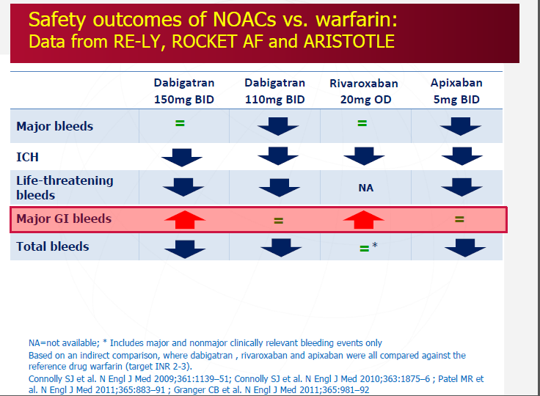

Slide 38
Eliquis je jedini NOAK koji je pokazao superiornost vs. varfarina u slijedeća tri ishoda
Superior
stroke/systemic embolism prevention
Superior
profile in
major bleeding
Superior
reduction in
all-cause mortality
Superior stroke/systemic embolism prevention
21% RRR
P=0.01
31% RRR
P<0.001
11% RRR
P=0.047
669/
9081
603/
9120
462/
9052
327/
9088
212/
9120
265/
9081
Apixaban
Warfarin
Apixaban
Warfarin
Apixaban
Warfarin
Warfarin target INR 2.0‒3.0
Created from Connolly et al. N Engl J Med 2011;364:806-17
RRR, relative risk reduction
Granger et al. N Engl J Med 2011;365:981-92

Slide 39

Zašto birati između učinkovitost i sigurnosti?
Većina pacijenata su starije životne dobi s višestrukim komorbiditetima,
izloženi polifarmaciji¹
Faza 3 randomiziranih kliničkih studija pokazuju prednosti NOAC-a naspram varfarina u starijih pacijenata s AF koji su konzistentni ishodima u ukupnoj populaciji²
OAC FORTA klasifikacija podupire prikladnost NOAC-a kod starijih pacijenata s AF³
Eliquis je dokazao signifikantno smanjenje oba rizika naspram varfarina, i od moždanog udara i od velikih krvarenja⁴ u ukupnoj populaciji, a dodatnu potvrdu daje činjenica da je prvi izbor kod najzahtjevnijih i najtežih pacijenata
  Kliničke smjernice preporučuju NOAC-e kao prvu liniju antikoagulacije u većine pacijenata s AF⁵
1. Romano, et al. Nat Rev Neurol 2015;11:619–621; 2. Hart, et al. Neurol Clin Pract 2014;4:96–98; 3. Ruff CT, et al. Lancet 2014;383:955–962; 4. Granger CB, et al. N Engl J Med 2011;365:981–92;
5. Kirchhof P, et al. Eur Heart J 2016;37:2893–2962

